Slide 1
Progress Presentation 2
Team Blue

Slide 2
We’ve implemented Master and Worker… kind of

Slide 3
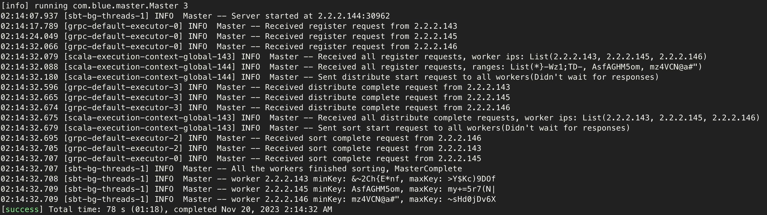
Master

Slide 4
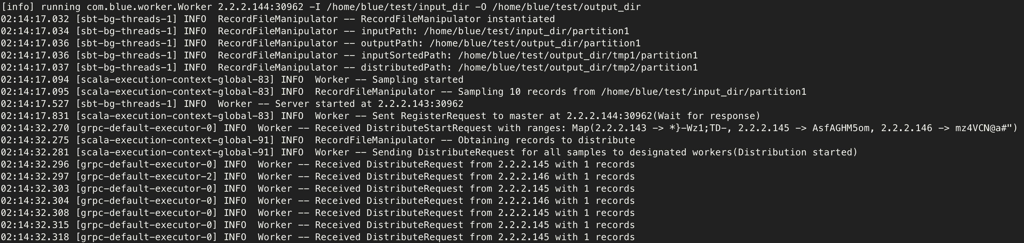
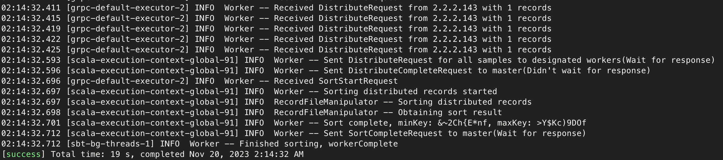
Worker

Slide 5
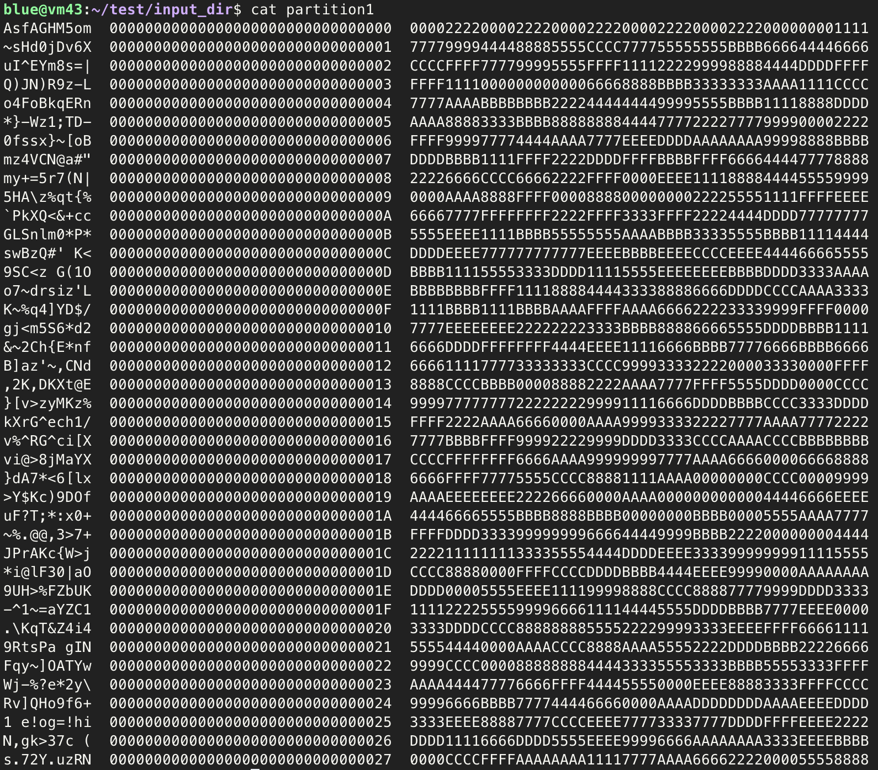
result

Slide 6
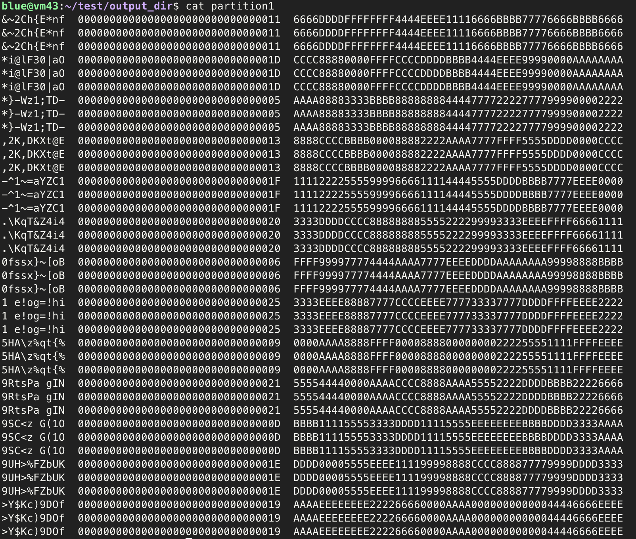
result

Slide 7
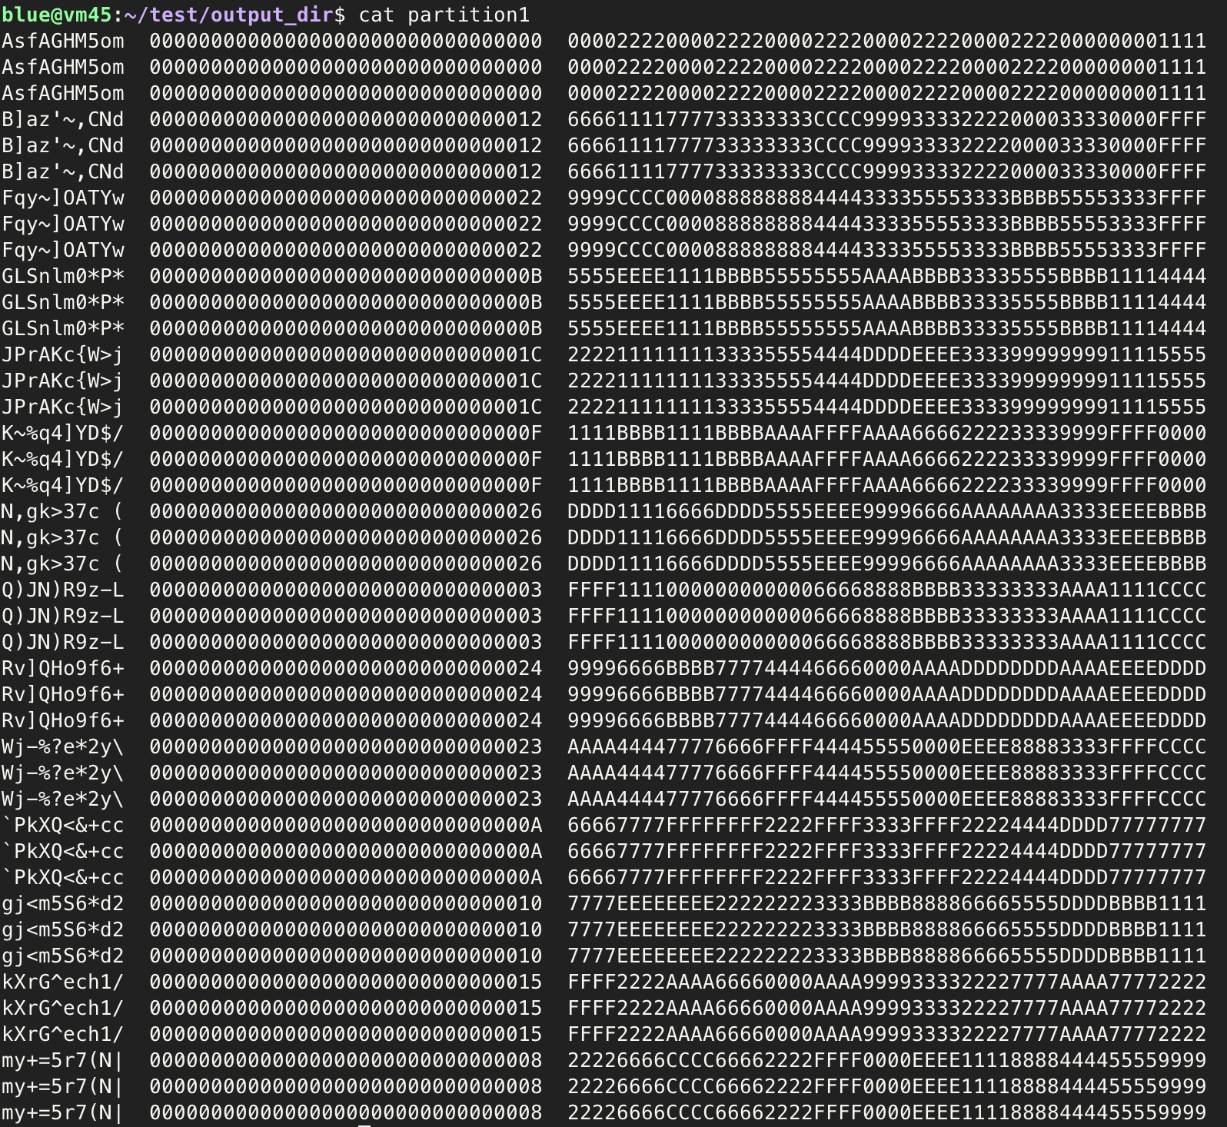
result

Slide 8
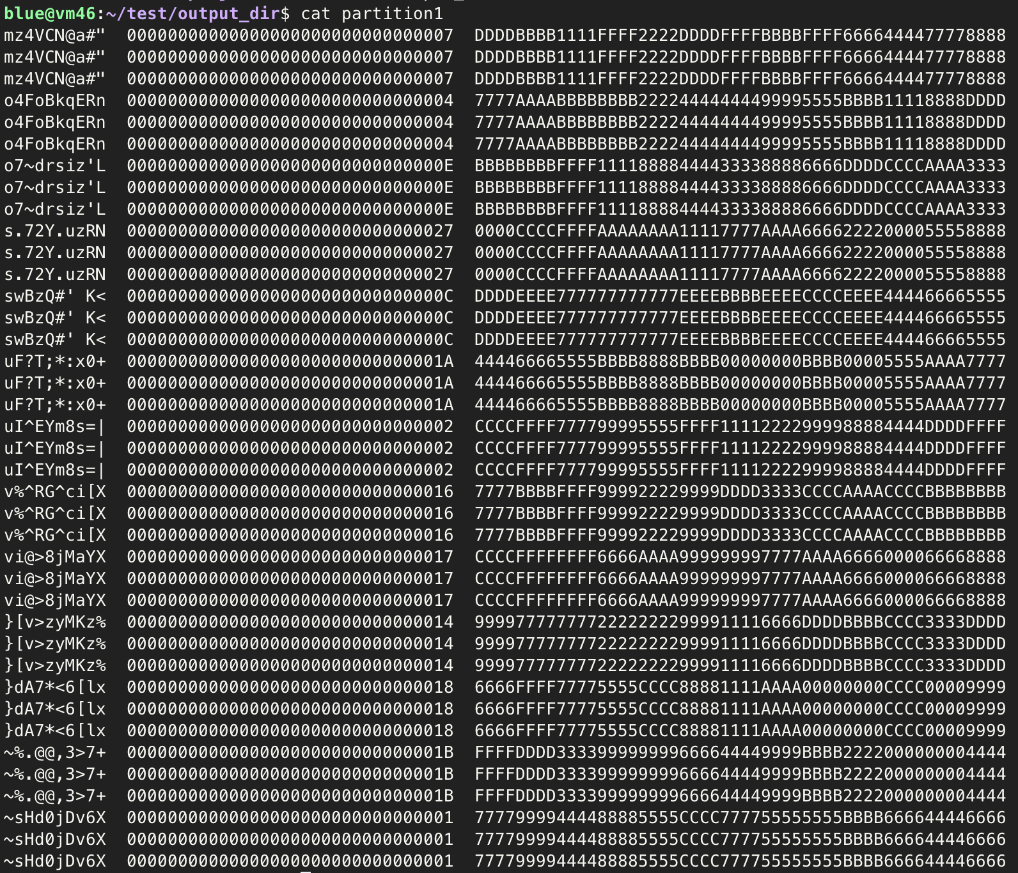
result

Slide 9
However
We did not complete worker file IO(worker only takes file named ”partition1” as input)
We did not complete worker on-disk sorting(worker does on-memory sorting)
We handle input/output as String, not ByteString(gensort must be created with –a option)

Slide 10
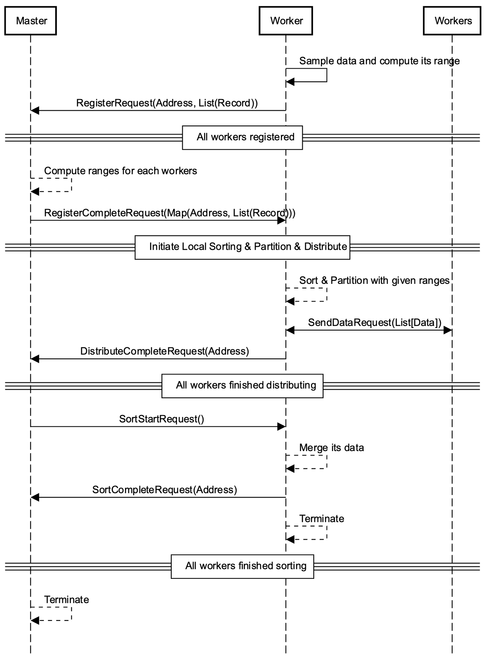
Overall Control Flow with Protocol Definition

Slide 11
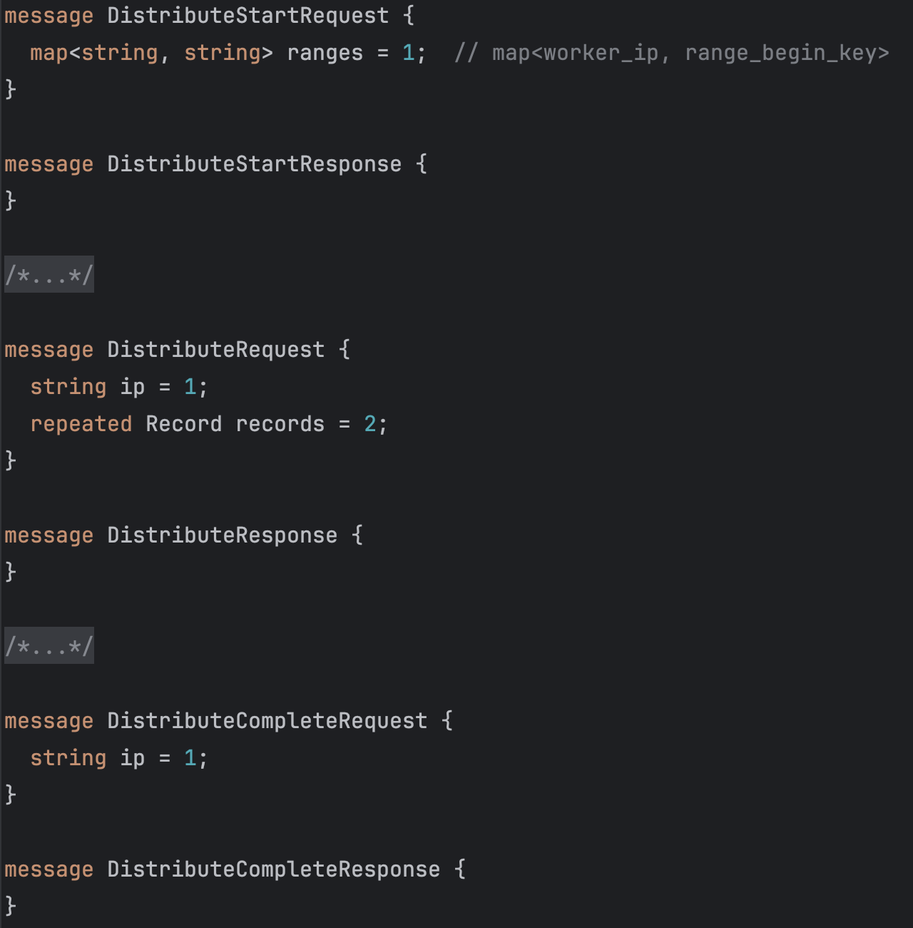
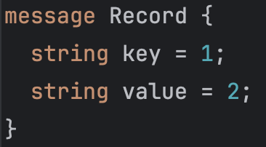
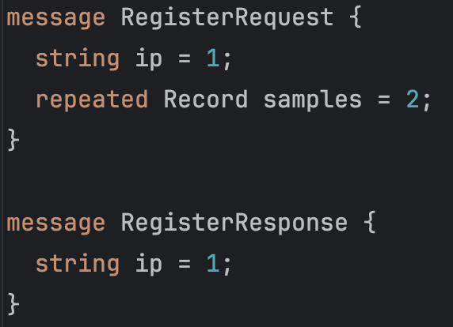
protobuf

Slide 12
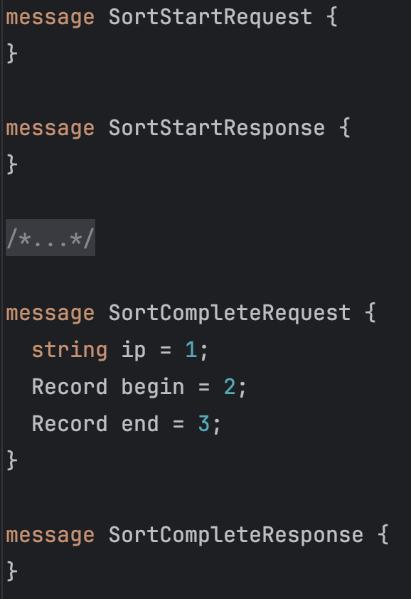
protobuf

Slide 13
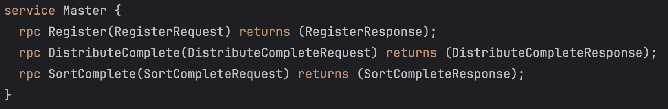
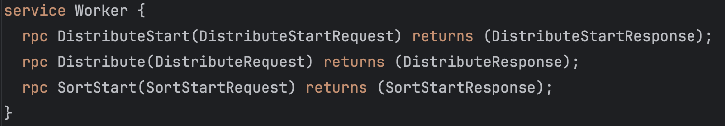
protobuf

Slide 14
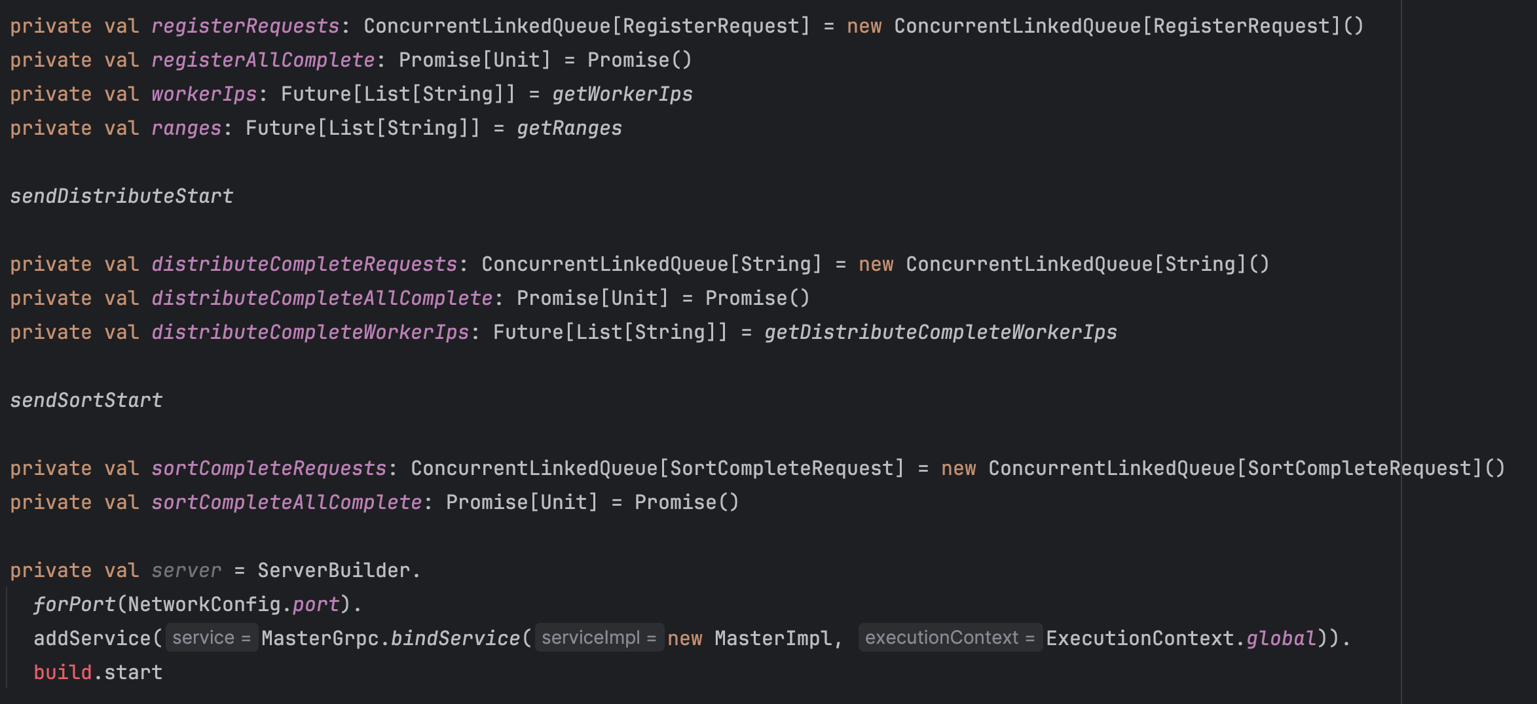
Master

Slide 15
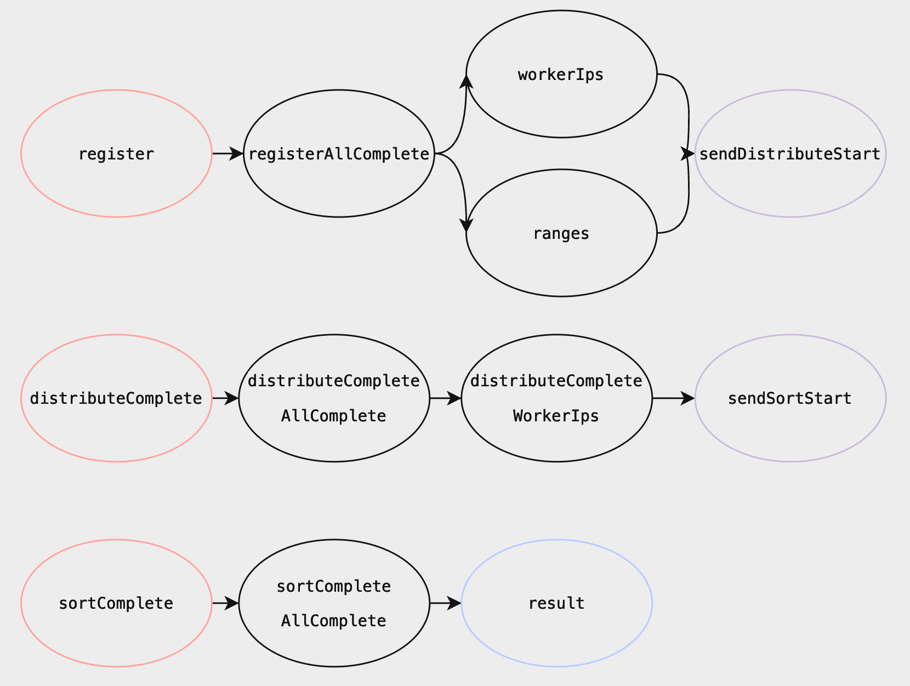
Master
Pink: gRPC Service
Black: Promise(or Future)
Purple: function returning Future[Unit]
Blue: Result of Await.Result

Slide 16
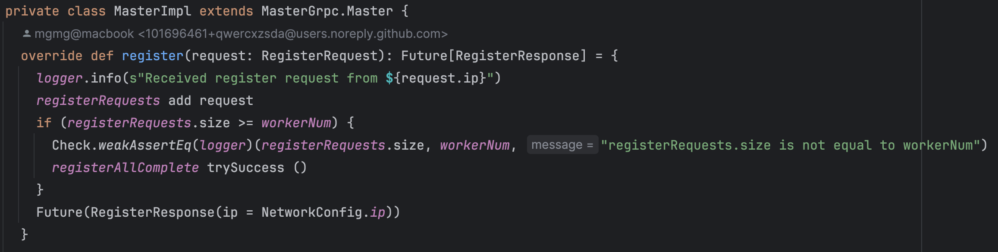
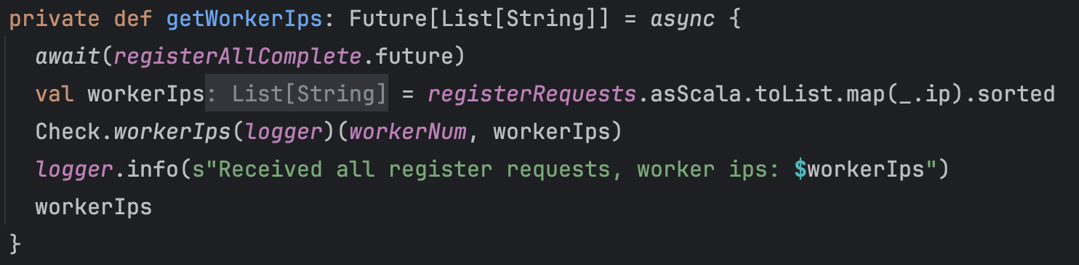
Master

Slide 17
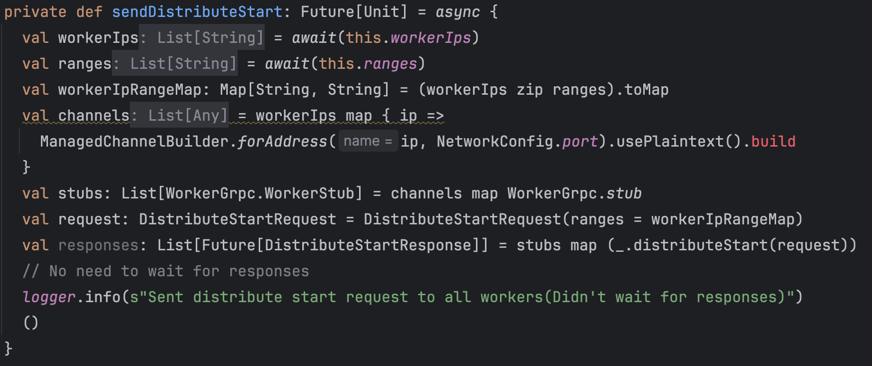
Master

Slide 18
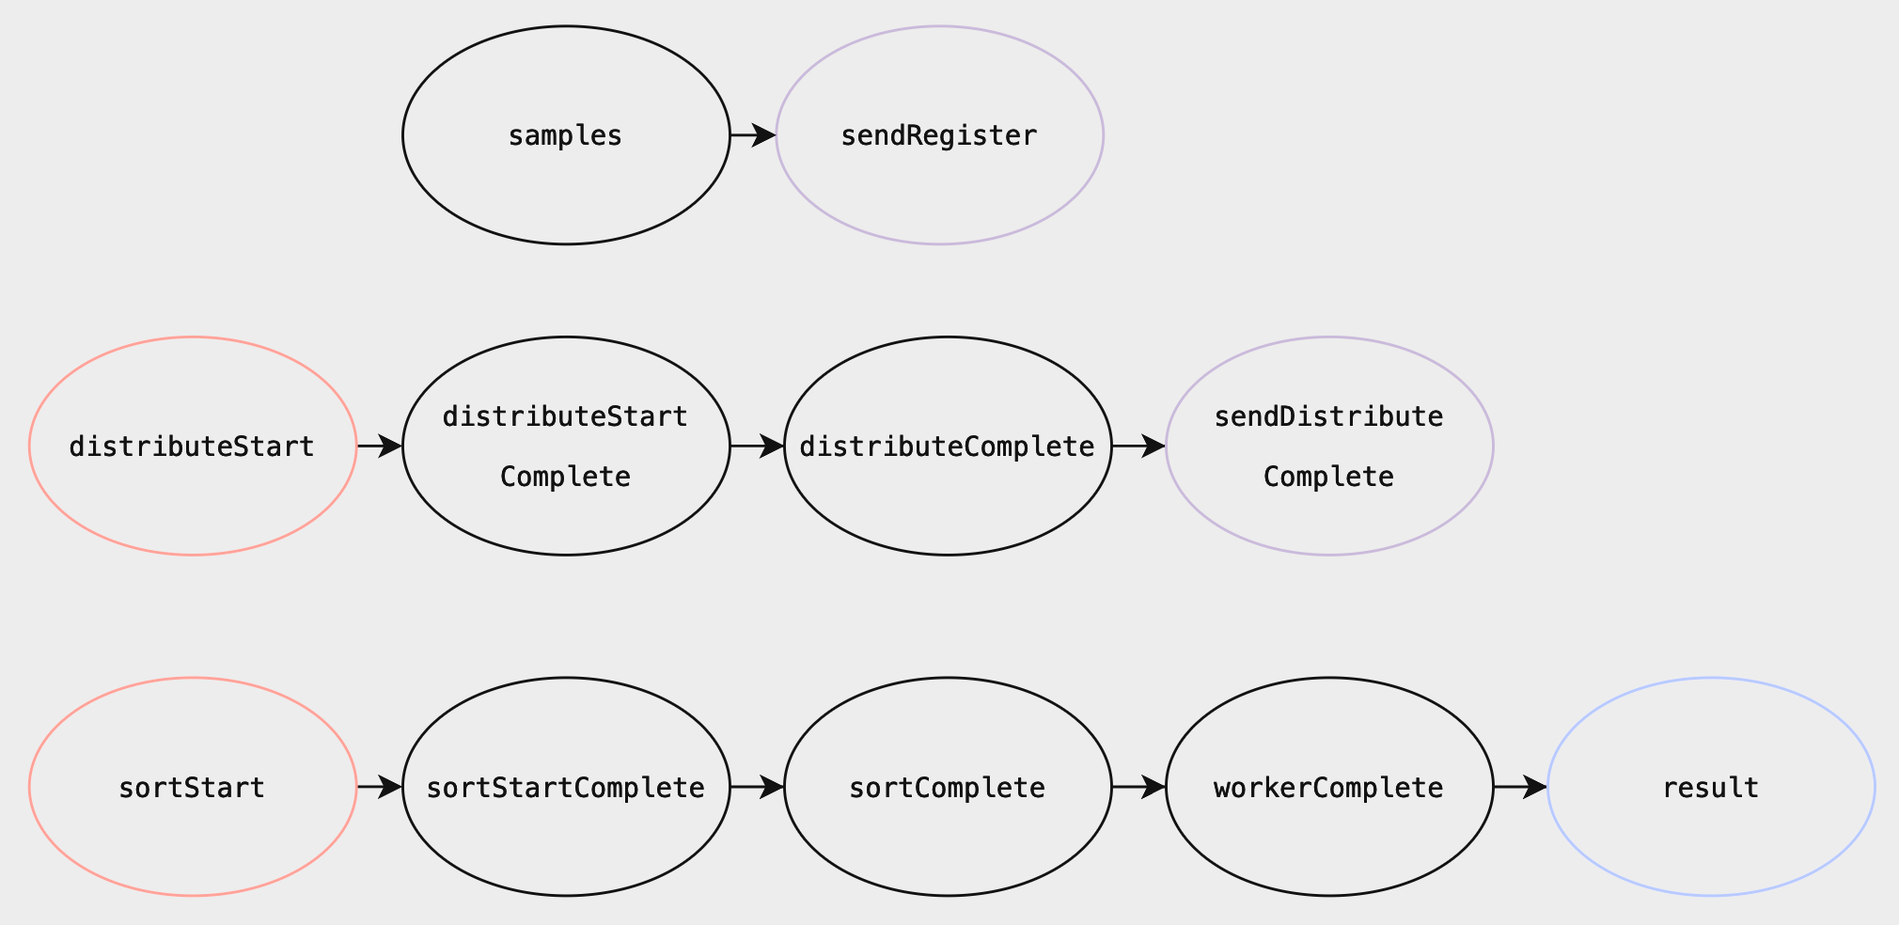
Worker
Pink: gRPC Service
Black: Promise(or Future)
Purple: function returning Future[Unit]
Blue: Result of Await.Result

Slide 19
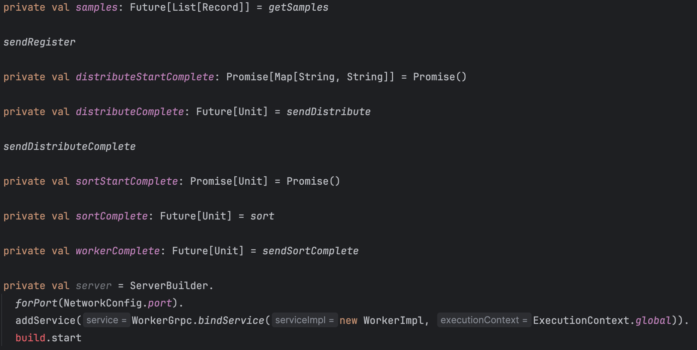
Worker

Slide 20
Libraries
Communication – ScalaPB, grpc-netty
Logging - scala-logging (scala wrapper for log4j)

Slide 21
Previous Milestones
Milestone 1
Generate input data
Connect Master & Worker nodes
Configure gRPC
Milestone 2
Worker samples data -> give master its range
Master computes ranges for each worker nodes given worker's range -> distribute it to workers with (range, ipaddress) list
Milestone 3
Workers sort and partition its data (should decide the size of partitioned file)
Workers distribute its files to appropriate node range.
Workers merge data
Workeres terminate & notify master

Slide 22
Milestones
Milestone 1
Generate input data - done
Connect Master & Worker nodes - done
Configure gRPC - done
Milestone 2
Worker samples data: done
Master computes ranges for each worker nodes given worker's range -> distribute it to workers with (range, ipaddress) list: done
Workers merge data : Moved from 3 to 2, done
Can execute(send) protocols in other, concurrently in Worker & Master using future & promise with dummy data, done
Milestone 3
Workers sort and partition its data (should decide the size of partitioned file)
Workers distribute its files to appropriate node range.
Workers terminate & notify master
Can execute(send) protocols in other, concurrently in Worker & Master using future & promise with real data (merge top-down & bottom-up work)

Slide 23
Master
Done: Overall control flow & interface, await register, compute range, initiate sorting
Not done: change the type of records from string -> byte[]

Slide 24
Worker
Done: Overall control flow & interface, sample data, merge data
Not done: sort&partition data, distribute data, change the type of records from string -> byte[]

